Slide 1
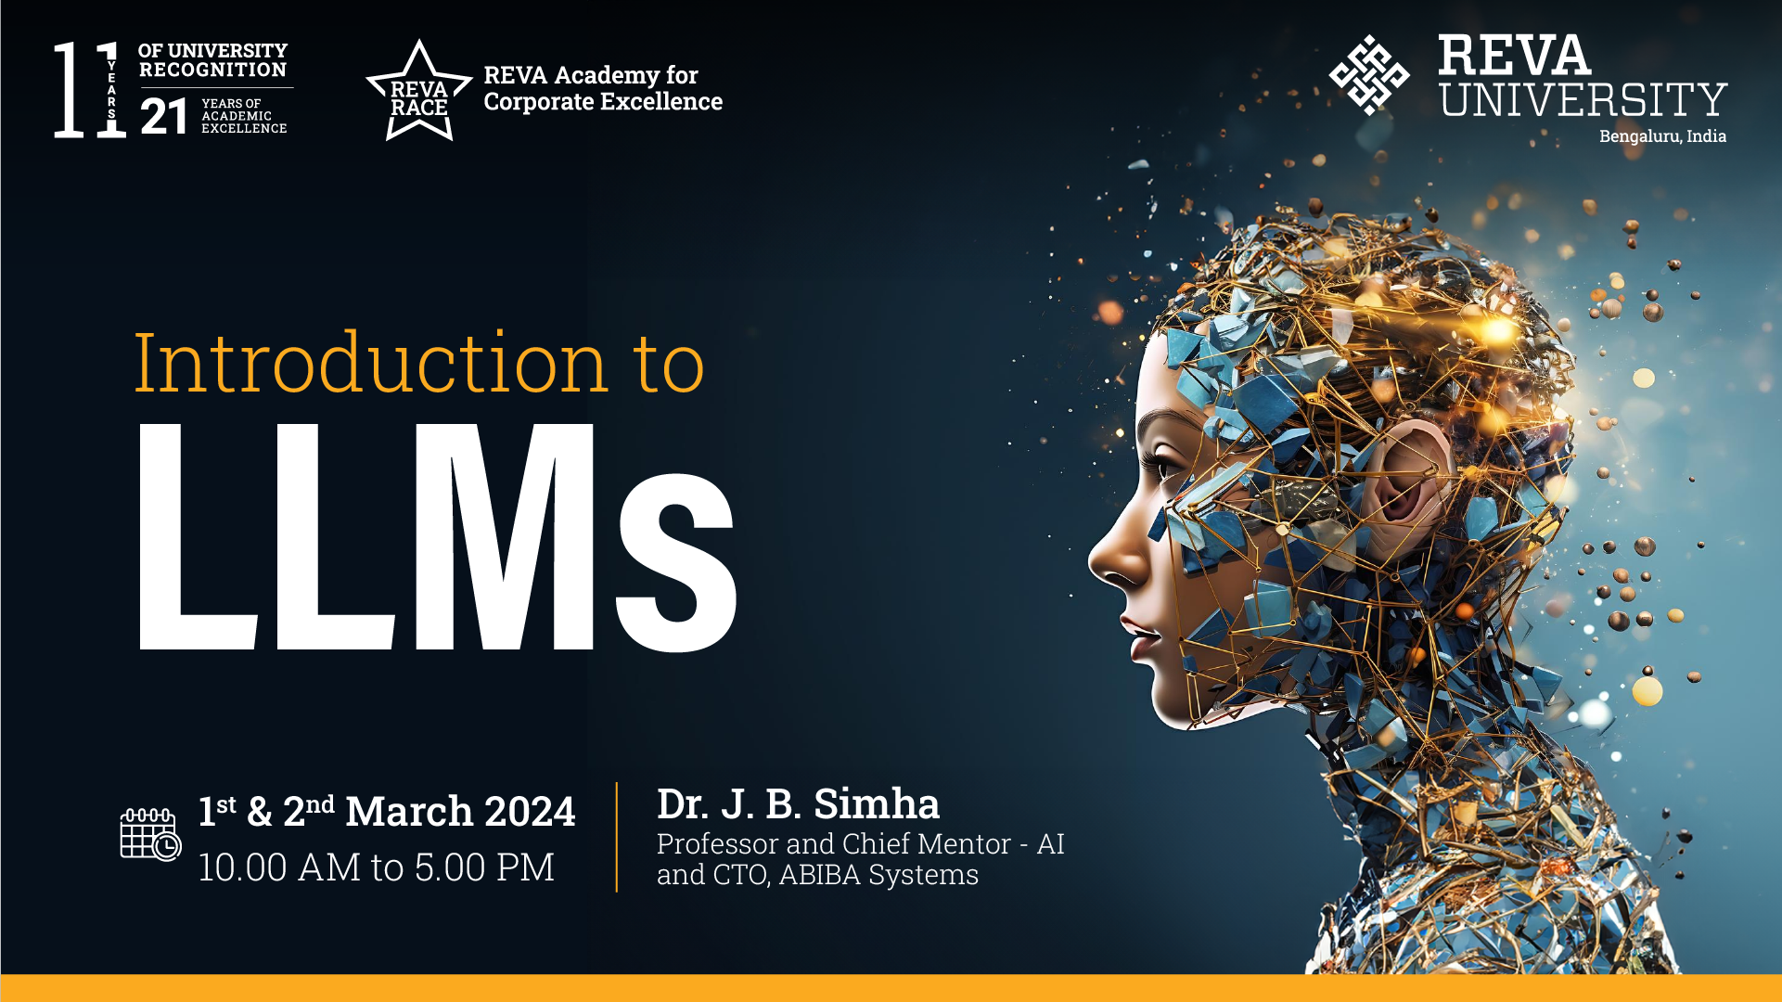

Slide 2
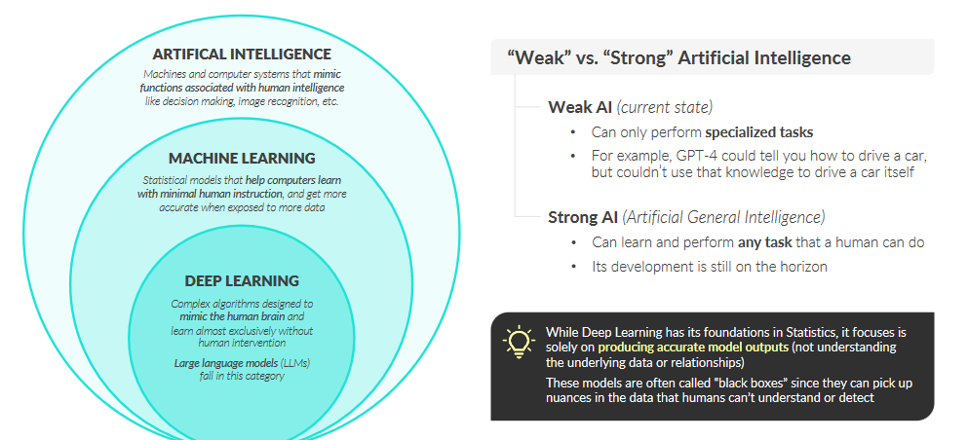
AI (ML DL and rest)

Slide 3

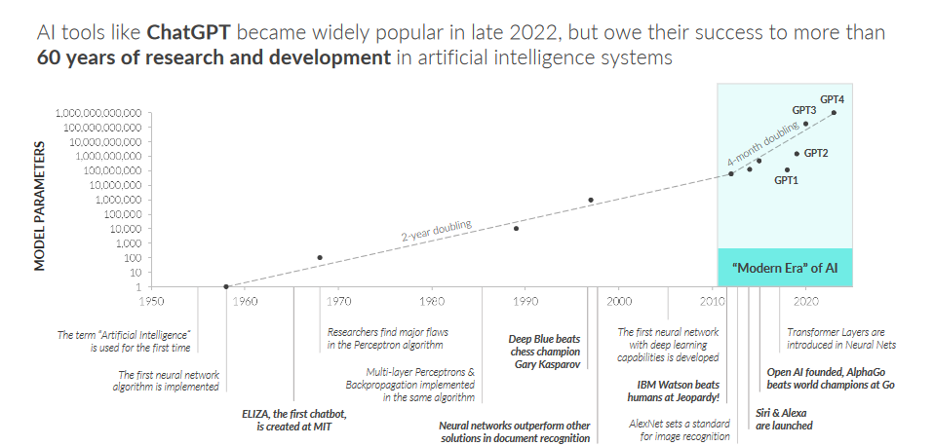
AI history and trend
3
REVA Academy for Corporate Excellence - RACE

Slide 4
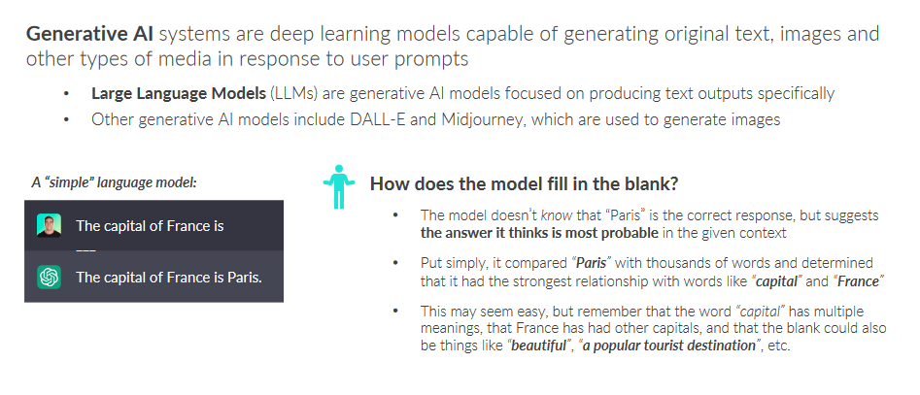
Generative AI
4
REVA Academy for Corporate Excellence - RACE

Slide 5
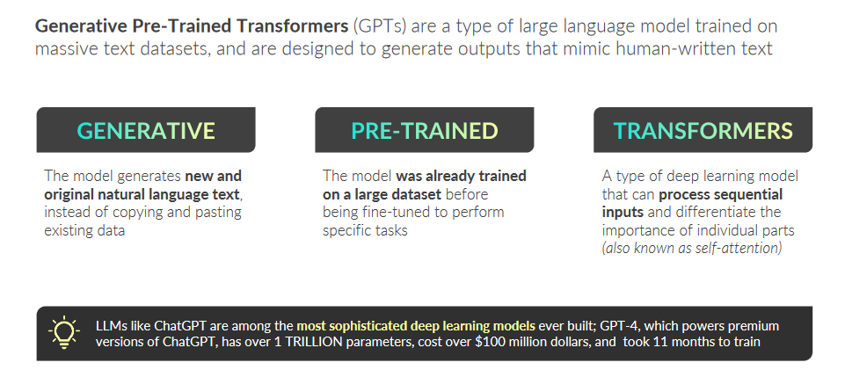
5
REVA Academy for Corporate Excellence - RACE

Slide 6
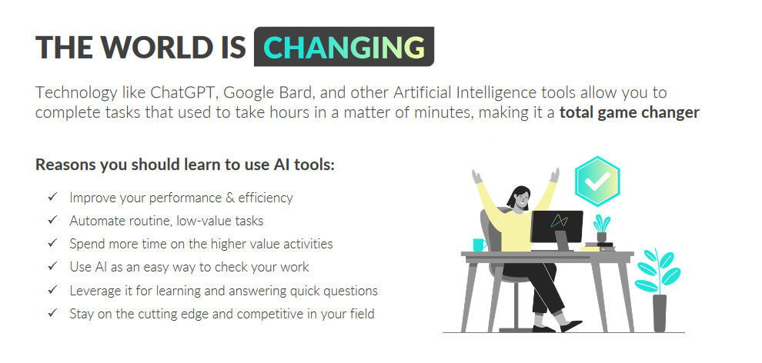
6
REVA Academy for Corporate Excellence - RACE

Slide 7
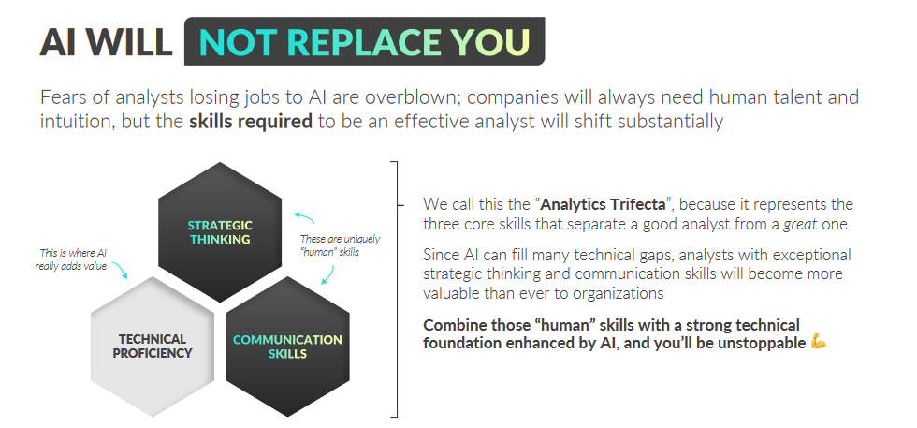
7
REVA Academy for Corporate Excellence - RACE

Slide 8
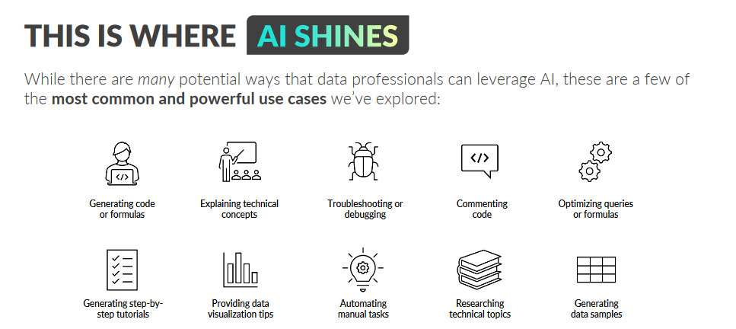
8
REVA Academy for Corporate Excellence - RACE

Slide 9
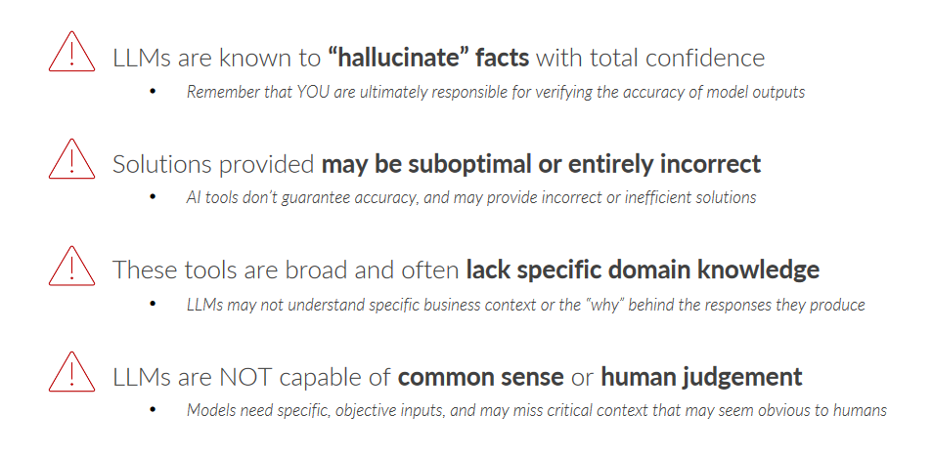
LLM Risks
9
REVA Academy for Corporate Excellence - RACE

Slide 10
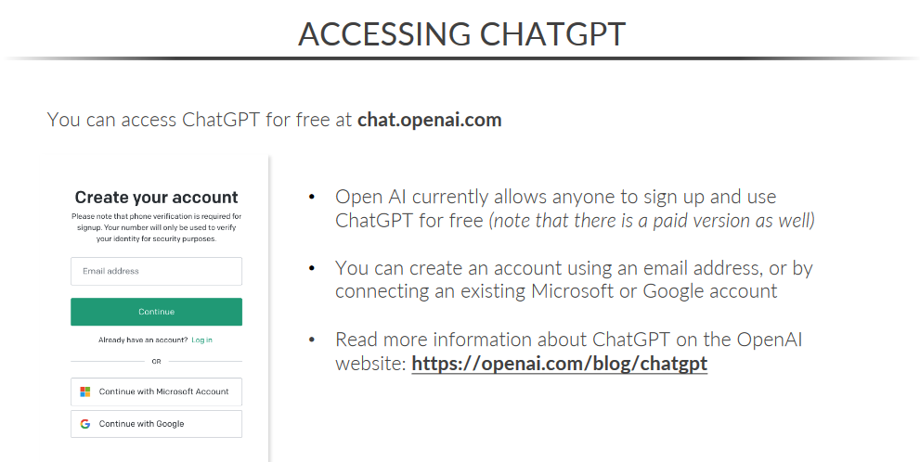
10
REVA Academy for Corporate Excellence - RACE

Slide 11
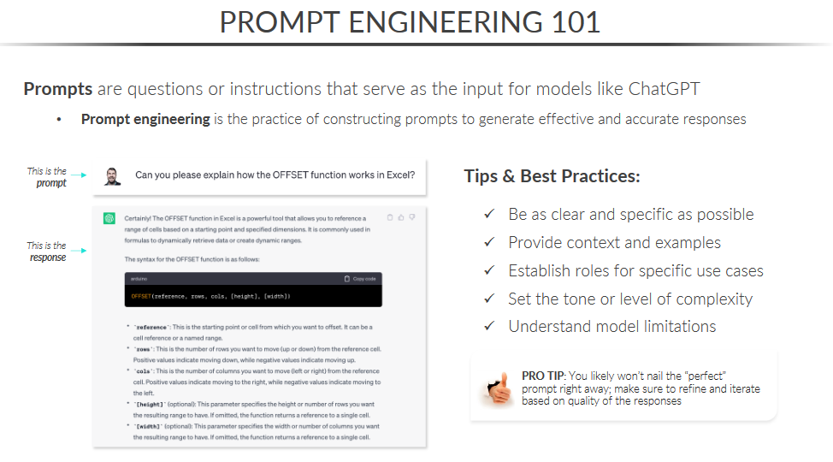
11
REVA Academy for Corporate Excellence - RACE

Slide 12
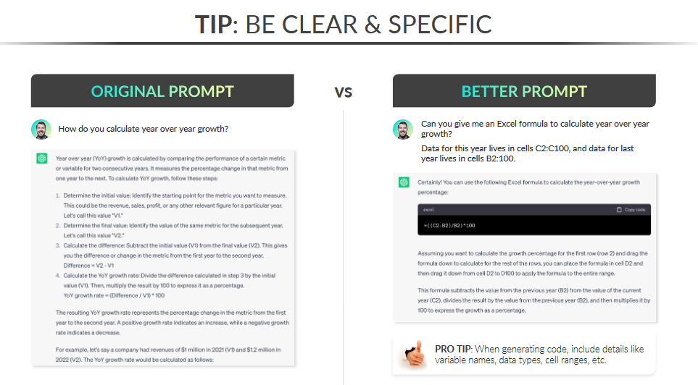
12
REVA Academy for Corporate Excellence - RACE

Slide 13
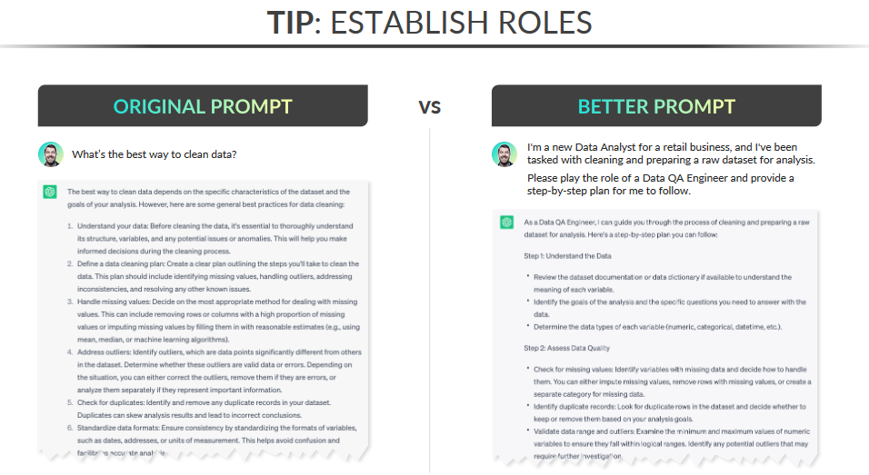
13
REVA Academy for Corporate Excellence - RACE

Slide 14
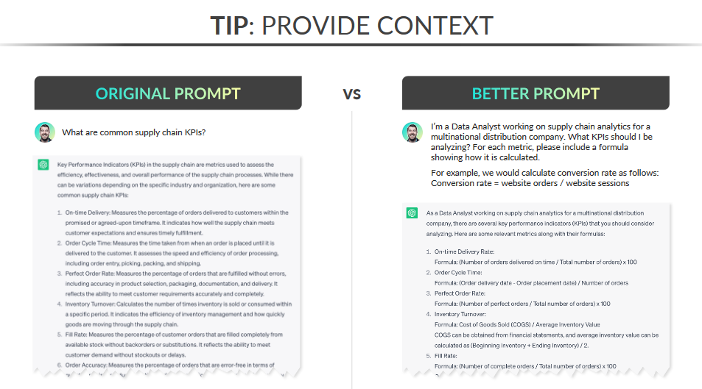
14
REVA Academy for Corporate Excellence - RACE

Slide 15
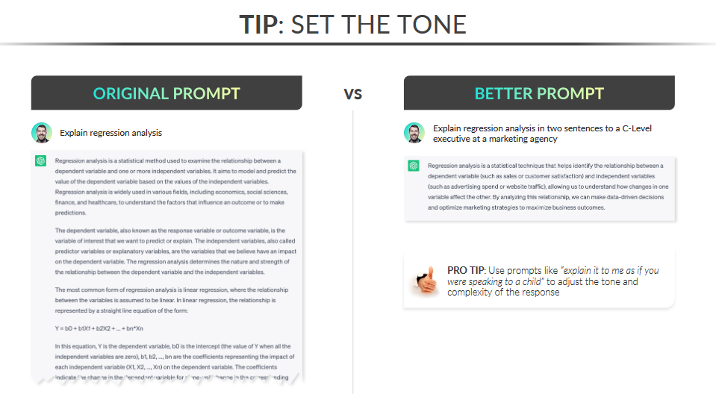
15
REVA Academy for Corporate Excellence - RACE

Slide 16
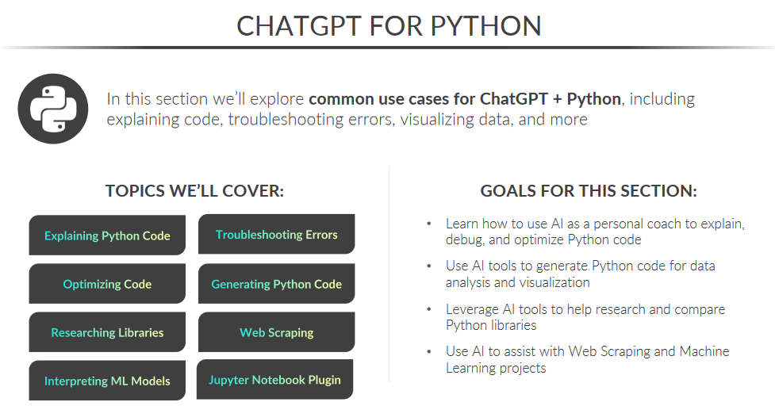
16
REVA Academy for Corporate Excellence - RACE

Slide 17
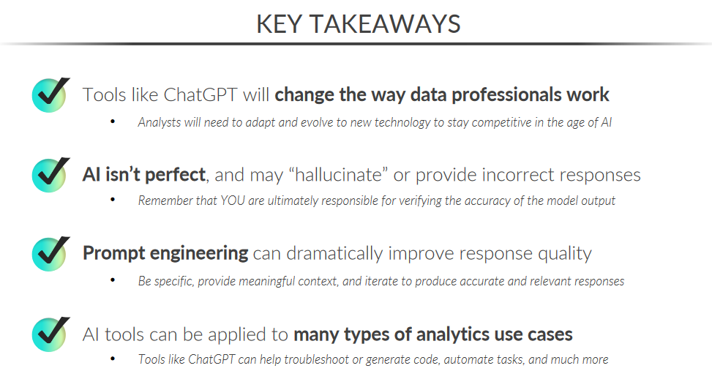
17
REVA Academy for Corporate Excellence - RACE

Slide 18
References
Mavenanalytics.com
Openai.com
Python.org
18
REVA Academy for Corporate Excellence - RACE

